Slide 1
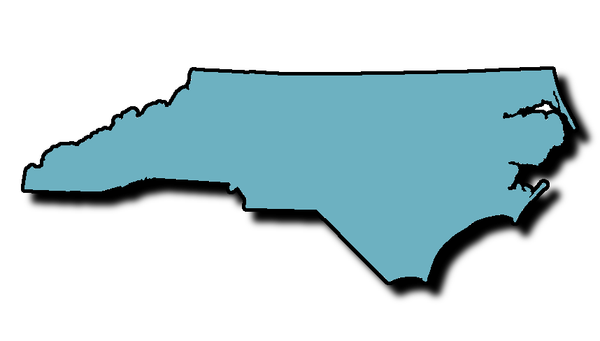
How CAFOs Are Destroying Vulnerable North Carolina Communities
Christine Ball-Blakely

Slide 2
Roadmap
1: What is a CAFO?
2: How are CAFOs harmful?
3. What laws apply to CAFOs?
4. Are there special interests at play?
5. What is notable about North Carolina?
6. How do we fix this?

Slide 3
What is a CAFO?
AFO (“Animal Feeding Operation”)
Agricultural enterprise where animals are kept and raised in confined living conditions.
Congregate animals, feed, manure and urine, dead animals, and production operations on a small land area.
Feed brought to animals rather than the animals grazing or otherwise seeking feed in pastures, fields, or on rangeland.
Sources
40 C.F.R. § 122.23(b) (2012).
USDA Natural Resources Conservation Service, Animal Feeding Operations, https://www.nrcs.usda.gov/wps/portal/nrcs/main/national/plantsanimals/livestock/afo/.

Slide 4
What is a CAFO?
CAFO (“Concentrated Animal Feeding Operation”)
A medium or large AFO
1000 meat cows, 700 dairy cows, 2500 pigs weighing more than 55 lbs, 125 thousand broiler chickens, or 82 thousand laying hens or young hens
Confined on site for more than 45 days in a year
Any size AFO that discharges manure or effluent into a natural or man-made ditch, stream or other waterway
Sources
40 C.F.R. § 122.23(b) (2012).
USDA Natural Resources Conservation Service, Animal Feeding Operations, https://www.nrcs.usda.gov/wps/portal/nrcs/main/national/plantsanimals/livestock/afo/.

Slide 5
What is a CAFO?

Slide 6
What is a CAFO?

Slide 7
What is a CAFO?

Slide 8
What is a CAFO?

Slide 9
How CAFOs Harm
Water pollution
Air pollution
Noxious odors
Insect vectors
Pathogens
Heavy truck traffic
Decreased property values
Sick community members and workers
Sources:
Carrie Hribar, National Association of Local Boards of Health, Understanding Concentrated Animal Feeding Operations and Their Impact on Communities, https://www.cdc.gov/nceh/ehs/docs/understanding_cafos_nalboh.pdf.
Sue Sturgis, A Step Toward Environmental Justice in North Carolina’s Hog Country, Facing South (February 3, 2017), https://www.facingsouth.org/2017/02/step-toward-environmental-justice-north-carolinas-hog-country.
Wendee Nicole, CAFOs and Environmental Justice: The Case of North Carolina, Environmental Health Perspectives (Jun. 1, 2013), https://ehp.niehs.nih.gov/121-a182/.

Slide 10
How CAFOs Harm: Water Pollution
Water pollution
CAFOs can produce more waste than cities
800,000 pigs could produce more than 1.6 million tons of waste per year – more than 1.5 times more than Philadelphia
CAFO waste contains a cocktail of pollutants
E. coli, growth hormones, antibiotics, animal blood, copper sulfate, nitrogen, phosphorus, silage leachate, and cleaning agents
Source
Carrie Hribar, National Association of Local Boards of Health, Understanding Concentrated Animal Feeding Operations and Their Impact on Communities 2, https://www.cdc.gov/nceh/ehs/docs/understanding_cafos_nalboh.pdf.
Notes:
First: A single pig produces up to four times more waste than a human. (Some other sources say up to ten times.) Second: A single cow produces up to twenty-three times more waste than a human.
Third: Important to note: we have sewage treatment plants for human waste. There is no such thing for CAFO waste.

Slide 11
How CAFOs Harm: Water Pollution
Disposal of manure
Applied to fields
Trucked offsite
Stored
Deep pits under buildings
Pumped into “lagoons”
Source
Carrie Hribar, National Association of Local Boards of Health, Understanding Concentrated Animal Feeding Operations and Their Impact on Communities 3, https://www.cdc.gov/nceh/ehs/docs/understanding_cafos_nalboh.pdf.

Slide 12
How CAFOs Harm: Water Pollution

Slide 13
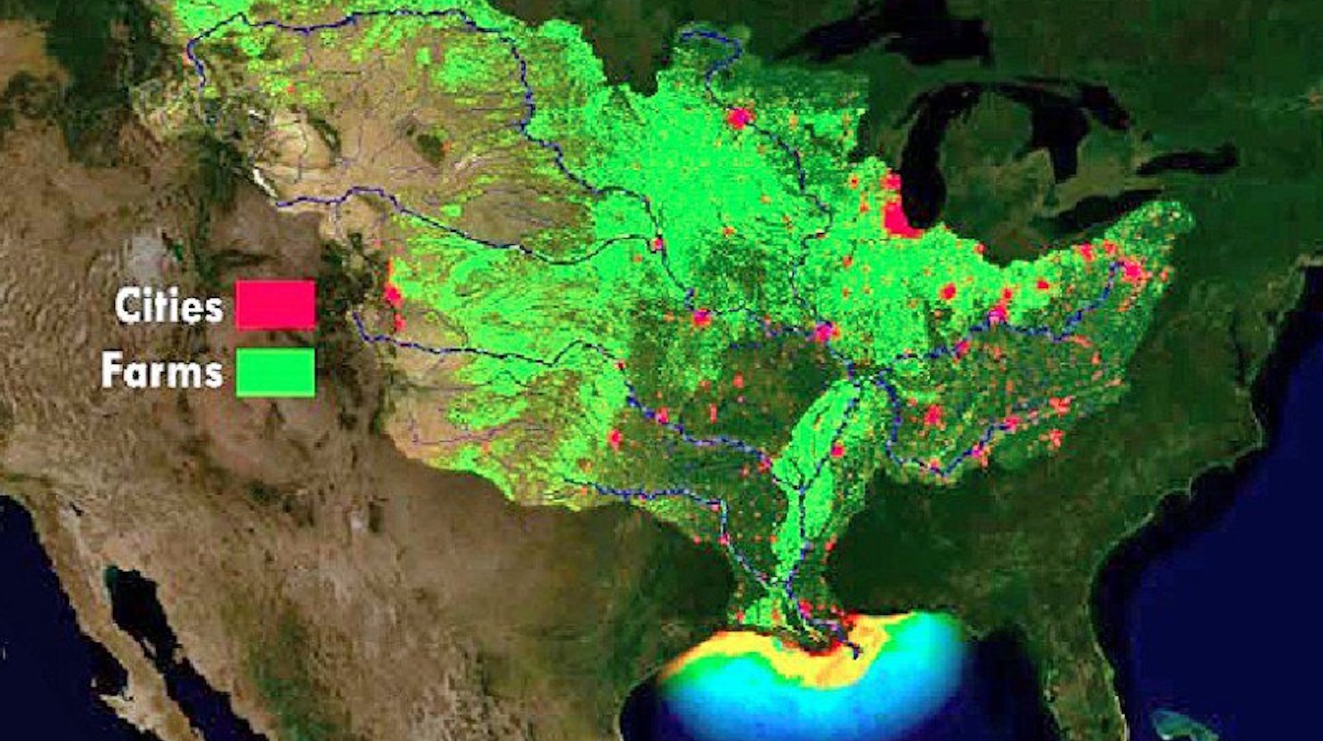
How CAFOs Harm: Water Pollution
Ground and spray field application
Seeps into groundwater
Pollutes surface waters, which run into WOTUS and…

Slide 14
How CAFOs Harm: Water Pollution

Slide 15
How CAFOs Harm: Air Pollution
Gas emissions
Ammonia, hydrogen sulfide, methane, carbon dioxide, and volatile organic compounds
Comes from animals, lagoons, spray fields, etc..
Particle emissions
Comes from feed and animal dander
Rapidly dispersed through atmosphere and deposited on land
Source
Claudia Copeland, Cong. Research Serv., RL 32947, Air Quality Issues and Animal Agriculture: EPA’s Air Compliance Agreement 1 (2014).

Slide 16
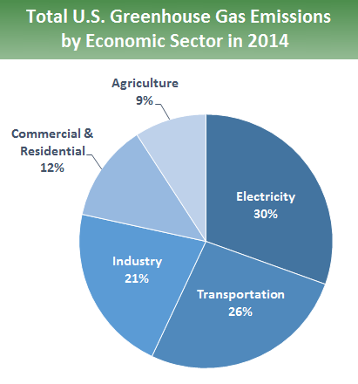
How CAFOs Harm: Air Pollution
Source
EPA, Sources of Greenhouse Gas Emissions, https://www.epa.gov/ghgemissions/sources-greenhouse-gas-emissions.

Slide 17
Federal Laws and Regulations?
Clean Water Act (CWA)
Authorizes the regulation and enforcement of requirements that govern waste discharges into WOTUS.
Clean Air Act (CAA)
Authorizes EPA to 1) set mobile source limits, ambient air quality standards, hazardous air pollutant emission standards, standards for new pollution sources, and significant deterioration requirements; 2) identify areas that do not attain federal ambient air quality standards set under the act; to administer a cap-and-trade program to reduce acid rain; 3) phase out substances that deplete the Earth’s stratospheric ozone layer.
Comprehensive Environmental Response, Compensation, and Liability Act (CERCLA)
Addresses cleanup of contamination when hazardous substances are released.
Emergency Planning and Community Right-to-Know Act (EPCRA)
Addresses industrial reporting of toxic releases.
Source
David M. Bearden et al, Cong. Research Serv., RL 30798, Environmental Laws: Summaries of Major Statutes Administered by the Environmental Protection Agency (2013).

Slide 18
Clean Water Act
CAFOs are point sources under CWA.
Subject to NPDES permitting under section 402.
May not discharge pollutants into WOTUS without a permit.
Each permit establishes effluent limitations in accordance with the effluent limitation guidelines.
Source
40 C.F.R. § 122 (2012).
Notes:
*Note most agricultural activities create run-off – like the manure applied to field – and are not regulated under CWA.

Slide 19
Clean Water Act: A Timeline
1974: EPA regulates CAFOs for the first time
Defines CAFOs.
Sets forth NPDES permitting requirements, and establishes effluent limitation guidelines.
2003: CAFO Rule
The first update since 1974.
Aimed to update regulations in keeping with vastly changing landscape of industrial farming.
Aimed to address inadequate compliance.
Sources
41 Fed. Reg. 11,458 (Mar. 18, 1976); 39 Fed. Reg. 15 5704 (Feb. 14, 1974); 40 C.F.R. §§ 9, 122, 123, 412 (2003).

Slide 20
Clean Water Act: A Timeline
2003: CAFO Rule
All CAFOs must apply for NPDES permit.
Exception: Not required if CAFO has “no potential to discharge” manure, etc..
2005: Waterkeeper Alliance
Second Circuit directed EPA to remove requirement that all CAFOs get NPDES permit.
Sources
40 C.F.R. §§ 9, 122, 123, 412 (2003).
Waterkeeper Alliance v. EPA, 399 F.3d 486 (2d Cir. 2005).

Slide 21
Clean Water Act: A Timeline
2008: CAFO Rule in response to Waterkeepers
Revises requirement for all CAFOs to apply for NPDES permits.
Requires only CAFOs that discharge or propose to discharge to apply for permits.
2011: Nat’l Pork Producers Council
Fifth Circuit directed EPA to remove requirement that CAFOs that propose to discharge apply for NPDES permits.
2012: CAFO Rule in response to Nat’l Pork Producers Council
Eliminates requirement that CAFOs that propose to discharge must apply for permits.
Sources
40 C.F.R. §§ 9, 122, 412 (2008).
Nat’l Pork Producers Council v. Envtl. Prot. Agency, 635 F.3d 738, 745 (5th Cir. 2011).
40 C.F.R. § 122 (2012).
Notes:
Note: Pig CAFOs can meet no discharge requirements by having “site-specific best management practice effluent limitations.”

Slide 22
Clean Water Act: A Timeline
2015:
EPA estimated there were 19,245 total CAFOs in the United States
Of those, about 6,445 CAFOs (33%) have NPDES permits
Noncompliance widespread
Iowa only issued NPDPS permits to 2% of its CAFOs.
EPA almost never refers CAFO cases to DOJ for prosecution.
Sources
EPA, NPDES CAFO Permitting Status Report, https://www.epa.gov/sites/production/files/2016-06/documents tracksum_endyear2015 .pdf
Michele M. Merkel, EPA and State Failures to Regulate CAFOs Under Federal Environmental Laws: Outline of Remarks Prepared for the National Commission on Industrial Farm Animal Production Meeting on September 11, 2006, http://environmentalintegrity.org/pdf/publications/EPA_State_Failures_Regulate_CAFO.pdf.

Slide 23
Clean Air Act
CAA Technically covers CAFOs
National Ambient Air Quality Standards (“NAAQS”)
Mandatory Greenhouse Gas (“GHG”) Reporting Rule
But CAA Hardly ever enforced against CAFOs
Federal and state officials deprioritize enforcement of CAFOs because most CAFOs believed to be minor sources of air pollution.
Lack of adequate air quality monitoring.
Environmental groups say many CAFOs should be regulated as major sources.
Source
Claudia Copeland, Cong. Research Serv., RL 32947, Air Quality Issues and Animal Agriculture: EPA’s Air Compliance Agreement 1 (2014).

Slide 24
Clean Air Act
NAAQS
No specific application to agriculture
“Vast majority of states” not requiring agriculture industry to take any measures
Sources
Megan Stubbs, Cong. Research Serv., RL 41622, Environmental Regulation and Agriculture 9-13 (2014).
The National Ambient Air Quality Standards, EPA’s Ozone Air Quality Standards, https://www.epa.gov/sites/production/files/2015-10/documents/20151001ozone_agriculture.pdf.
Notes:
Remember from Grant’s extremely informative presentation: NAAQS (National Ambient Air Quality Standards) are standards for air that define what EPA thinks is clean air
EPA decides which areas of the US are “nonattainment” by looking at data submitted by states.
After an area is deemed nonattainment, state and local governments have three years to come up with a SIP (State Implementation Plan) outlining how they intend to make those areas meet the standards.

Slide 25
Clean Air Act
Mandatory GHG Reporting Rule
Addresses manure management systems.
EPA estimates only 107 livestock facilities would have to report.
Zero facilities have to comply right now - Congress barred EPA from using funds to implement mandatory GHG reporting for manure management facilities.
Sources
40 C.F.R. § 98.360 (2009).
Megan Stubbs, Cong. Research Serv., RL 41622, Environmental Regulation and Agriculture 9-13 (2014).

Slide 26
Clean Air Act
The Air Compliance Agreement
Between EPA and 2,568 AFOs
Representing 14,000 facilities
Agribusiness, including pork industry, proposed this agreement in 2002.
Environmental groups and state and local air quality officials were not included.
To get data on how much AFOs emit in exchange for safe harbor from enforcement under some portions of CAA, CERCLA, and EPCRA.
Two year monitoring program
Finally began in 2007
EPA released data in January 2011
Environmental Integrity Project analysis showed that particles, ammonia, and hydrogen sulfide exceeded CAA health-based standards, worker safety standards, and federal emission reporting limits.
Source
Claudia Copeland, Cong. Research Serv., RL 32947, Air Quality Issues and Animal Agriculture: EPA’s Air Compliance Agreement 1 (2014).

Slide 27
CERCLA and EPCRA
CERCLA
All livestock operations are exempt from requirement to report to federal officials when they release hazardous substances into the air.
EPCRA
Many livestock operations exempt from reporting under this act, though CAFOs are NOT exempt if they fall under CWA.
Sources
40 C.F.R. § 302,355 (2008).
Megan Stubbs, Cong. Research Serv., RL 41622, Environmental Regulation and Agriculture 9-13 (2014).
Notes:
So both of these laws have reporting requirements that are triggered when certain quantities of substances like ammonia and hydrogen sulfate are released into the environment. Both also have citizen suit provisions that folks have successfully used against poultry and pig operations.
NOTE: THIS WAS JUST REPORTING. EPA was NOT looking to regulate with these.

Slide 28
Special Interests: Agribusiness
“Despite . . . documented environmental and human health harms from CAFO pollution, the industry and its allies have been able to emasculate government protection of its citizens at every level. Local governments have been stripped of control in many communities, preventing them from passing zoning or public health ordinances to address CAFO pollution. State and federal permitting and enforcement activity is nonexistent or weak. . . .”
Source
Michele M. Merkel, EPA and State Failures to Regulate CAFOs Under Federal Environmental Laws: Outline of Remarks Prepared for the National Commission on Industrial Farm Animal Production Meeting on September 11, 2006, http://environmentalintegrity.org/pdf/publications/EPA_State_Failures_Regulate_CAFO.pdf.

Slide 29
Special Interests: Agribusiness Lobby
EPA and states have authority to regulate CAFOs
But industry has undermined that authority
Agribusiness spent $126,242,202 in 2016
Agribusiness gave $2,091,657 to Trump Campaign
Source
OpenSecrets: Center for Responsive Politics, Agribusiness, https://www.opensecrets.org/industries/indus.php?cycle=2016&ind=A.
Notes:
American Farm Bureau Federation is especially powerful and skilled at manipulating the image people have of “farming” in America.
They represent big business, but nobody thinks of them that way. An excellent marketing campaign.

Slide 30
Environmental Injustice in North Carolina: A Case Study

Slide 31
North Carolina
“On the coastal plain of eastern North Carolina, families in certain rural communities daily must deal with the piercing, acrid odor of hog manure—reminiscent of rotten eggs and ammonia—wafting from nearby industrial hog farms. On bad days, the odor invades homes, and people are often forced to cover their mouths and noses when stepping outside. Sometimes, residents say, a fine mist of manure sprinkles nearby homes, cars, and even laundry left on the line to dry.”
Source
Wendee Nicole, CAFOs and Environmental Justice: The Case of North Carolina, Environmental Health Perspectives (Jun. 1, 2013), https://ehp.niehs.nih.gov/121-a182/.

Slide 32
North Carolina
Historical Perspective on Pig Farming
Swift transition from family farms to CAFOs.
15,000 farms to 2,000 + explosion of the pig population
Now 9 million pigs in the state
95% of those pigs in eastern North Carolina
Decrease in employment.
Put small farms out of business.
Create more waste than human populations of New York City, Chicago, and Los Angeles combined.
Source
Cordon M. Smart, The "Right to Commit Nuisance" in North Carolina: A Historical Analysis of the Right-to-Farm Act, 94 N.C. L. Rev. 2097, 2103-06 (2016).

Slide 33
North Carolina
Vulnerable Community
Portion of the state with a large African American, Hispanic, and Native American populations.
Slaves worked on plantations there before emancipation.
Upon emancipation, became sharecroppers and tenant farmers.
African American families here still experiencing high rates of poverty, poor health care options, poor educational outcomes, unemployment, and substandard housing.
African Americans, Hispanics and Native Americans living within 3 miles of a pig CAFO are 1.54, 1.39 and 2.18 times higher, respectively, than proportion of non-Hispanic whites.
Sources
Wendee Nicole, CAFOs and Environmental Justice: The Case of North Carolina, Environmental Health Perspectives (Jun. 1, 2013), https://ehp.niehs.nih.gov/121-a182/.
Steve Wing and Jill Johnston, Industrial Hog Operations in North Carolina Disproportionately Impact African-Americans Hispanics and American Indians (Aug. 29, 2014), https://www.facingsouth.org/sites/default/files/wing_hogs_ej_paper.pdf.

Slide 34
North Carolina
Health
Hydrogen sulfide and certain kinds of particulate matter correlated with increased blood pressure, respiratory difficulty, sore throat, chest tightness, nausea, eye irritation, stress, anxiety, and nervousness
Drinking water compromised.
Decreased quality of life
Community members stay inside or wear masks outdoors.
Manure layer covers their yards and homes.
Heavy truck traffic.
Decreased property values.
Source
Wendee Nicole, CAFOs and Environmental Justice: The Case of North Carolina, Environmental Health Perspectives (Jun. 1, 2013), https://ehp.niehs.nih.gov/121-a182/.
Notes:
This community already has a high stroke level.
Industry told some community members not to drink their own well water.
State/local health departments have no jurisdiction over CAFOs.
State environmental and natural resource agencies do, but their focus is not on health.

Slide 35
North Carolina

Slide 36
North Carolina

Slide 37
North Carolina

Slide 38
North Carolina
Lagoon rupture of 1995
Eight-acre lagoon spilled 22 million gallons of manure into the New River.
Millions of fish and other creatures died.
Groundwater
The coastal plain water table is near the surface.
Ammonia and nitrates seep into groundwater.
Only 12 of the 2,000 pig CAFOs were required to obtain a CWA permit.
Source
Wendee Nicole, CAFOs and Environmental Justice: The Case of North Carolina, Environmental Health Perspectives (Jun. 1, 2013), https://ehp.niehs.nih.gov/121-a182/.

Slide 39
North Carolina
Hurricane Matthew
Notes:
Millions of dead pigs and other farm animals in the water

Slide 40
North Carolina

Slide 41
North Carolina

Slide 42
North Carolina
“Right-to-Farm” Laws
Grant CAFOs explicit right to commit nuisance.
Severely curtain ability of community members to advocate for their neighborhoods and themselves.
Sources:
N.C. Gen. Stat. §§ 106-700, 106-701 (2016).
Cordon M. Smart, The "Right to Commit Nuisance" in North Carolina: A Historical Analysis of the Right-to-Farm Act, 94 N.C. L. Rev. 2097, 2098 (2016).
Notes:
William Aldred’s Case: Court of the King’s Bench recognized “[a]n action on the case lies for erecting a hogstye so near the house of the plaintiff that the air thereof was corrupted.”

Slide 43
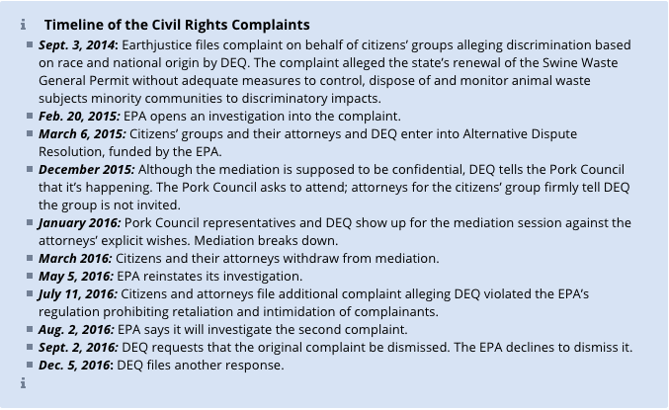
North Carolina: Fighting Back

Slide 44
North Carolina: Fighting Back
Civil Rights Investigation
EPA’s External Civil Rights Compliance Office (ECRCO) sent letter to N.C. Department of Environmental Quality (NCDEQ).
“Deep concern” that NCDEQ has failed to adequately regulate pig CAFOs.
Called for meeting with NCDEQ to explore informal resolution.
ECRCO called on NCDEQ to evaluate whether its policies fulfill federal nondiscrimination law requirements.
Title VI of the Civil Rights Act of 1964
Prohibits recipients of federal funding from discriminating
Executive Order 12,898
Environment-specific
Sources
Juan Carlos Rodriguez, EPA Rights Office Finds Mich. Discriminated Against Blacks, Law360 (Jan. 26, 2017) (also discussing North Carolina case).
Letter from Marianne Engelman Lado, Senior Staff Attorney, Earthjustice, to Lilian Dorka, Deputy Director, Acting Assistant Director, EPA ECRCO (Jul. 11, 2016).
Lisa Sorg, EPA to NC DEQ: “Grave Concerns” About Swine Industry’s Intimidation of Minority Residents, NC Policy Watch (Jan. 26, 2017), http://www.ncpolicywatch.com/2017/01/25/epa-nc-deq-grave-concerns-swine-industrys-intimidation-minority-residents/.
Letter from Lilian S. Dorka, Director, EPA ECRCO, to Will G. Ross, Jr., Acting Secretary, NCDEQ (Jan. 12, 2017).
Notes:
This all really took off when residents traveled to DC to speak with EPA officials. Officials did visit this area and gathered testimony from 80 community members who live near these facilities.

Slide 45
North Carolina: Grassroots Response
EPA and Congress: Not Viable (Yet)
Revisions needed to CAA and CWA and rules.
Lower thresholds to include CAFOs.
Fund enforcement.
Reverse CERCLA and EPCRA CAFO exemptions.
Regulate siting to address EJ issues.
Strong citizen suit provisions throughout.
Campaign finance reform and lobbying regulations.
State-By-State: Viable
Roll back “Right-to-Farm” laws.
Strengthen state air and water protections.
Focus on permitting/siting issues with CAFOs.
Hold NCDEQ accountable.
Increase transparency between NCDEQ and pork industry.

