Slide 1
CAFOs: Plaguing North Carolina Communities of Color
Christine Ball-Blakely
April 12, 2017

Slide 2
Roadmap
1. Recap of the Problem
CAFOs pollute, sicken, and impoverish
2. Impacted North Carolina Communities
3. Health Effects of CAFOs
4. Economic Effects of CAFOs
5. Lackluster Regulation
6. $pecial Interests and $ubsidies
7. Impacted Communities Fight Back
8. Next steps?

Slide 3
The Big Picture: Themes
Systemic racism
Jim Crow-style intimidation
CAFO operators usually white
Citizen activists usually African American
Poverty
Dirty money
The place of corporations in society
Non-human animal welfare
Federalism
Values
Who matters?

Slide 4
Recap: Lagoons
Notes:
Source of air pollution because of all the gases coming off of it
Source of water pollution because it leaches into the ground and sometimes breaches/overflows during severe weather (hurricanes)
Slow leaks can release large quantities of ammonium into the ground
The pipes from the barns to the lagoons also breach, leaking into the groundwater

Slide 5
Recap: Sprayfields
Notes:
Used to manage the volume in the lagoons
If applied in excess (more than the field can absorb), it runs off into surface waters
If it is applied when it is raining or when the field is frozen, it runs off into surface waters

Slide 6
Recap

Slide 7
Recap

Slide 8
Water Contaminants
Pathogens
Parasites, bacteria, and viruses
Over 150 in manure that cause disease/infection
Nitrates
Ammonium
Phosphate
Dissolved solids
Metals and metalloids
Copper, zinc, arsenic, nickel, selenium
Pharmaceutical chemicals
Antibiotics
Natural and synthetic hormones

Slide 9
Air Contaminants
Over 400 volatile organic compounds (VOC)
Particulate matter (PM)
Methane
Ammonia
Hydrogen sulfide (H2S)
Ozone
Endotoxin
Noxious odors

Slide 10
The “Black Belt”

Slide 11
The “Black Belt”
“So far as I can learn, the term was first used to designate a part of the country which was distinguished by the color of the soil. The part of the country possessing this thick, dark, and naturally rich soil was, of course, the part of the South where the slaves were most profitable, and consequently they were taken there in the largest numbers. Later, and especially since the war, the term seems to be used wholly in a political sense — that is, to designate the counties where the black people outnumber the white.” – Booker T. Washington, 1901
Notes:
Booker T. Washington described this term in his autobiography in 1901.

Slide 12
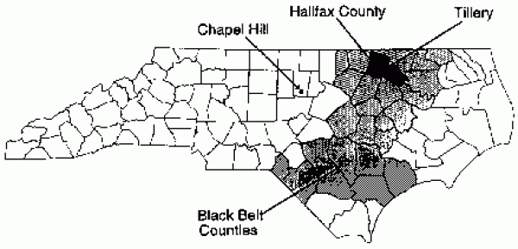
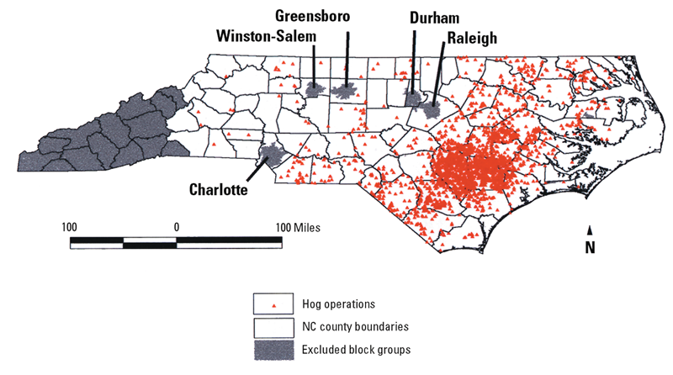
The “Black Belt”

Slide 13
The “Black Belt”
Slavery
Began in 1619 in the Colonies
Officially legalized in 1641
Plantation slavery grew after invention of cotton gin in 1973
4 million slaves by 1860s
More than half lived in plantation states
Emancipation in 1863
Sharecropping and tenant farming
Systematically deprived of farmland by discrimination in land sales and lending

Slide 14
The “Black Belt”
Proportion of African American, Hispanic, and Native American people living within three miles of a North Carolina pig CAFO are 1.54, 1.39, and 2.18 times higher, respectively. – Professor Wing

Slide 15
The “Black Belt”
Communities still suffering today
High unemployment
North Carolina African Americans: 17.4%.
North Carolina Caucasians: 8.7%
High poverty rate
North Carolina African Americans: 27.7%
North Carolina Caucasians: 11.8%
Low median income
North Carolina African Americans: $30, 952
North Carolina Caucasians: $49,383
High infant mortality
Black Belt = 125% of that in the non-South
Black Belt = 133% of that in the rest of the South
Low educational attainment
Sub-par healthcare
Low quality housing

Slide 16
Health Effects

Slide 17
Health Effects: Well Water
High level of reliance on wells for drinking water
3 million in North Carolina
High water tables + unlined wells = dangerous
No mandated oversight of water quality for private wells
Nitrates
North Carolina wells near CAFOs have elevated nitrates
“Blue Baby Syndrome”
Nitrates oxidize iron in hemoglobin in red blood cells to methemoglobin
Babies cannot convert methemoglobin back to hemoglobin quickly enough, which hinders ability of blood to carry oxygen
Notes:
The high water table means that the groundwater is close to the surface and more likely to be contaminated

Slide 18
Health Effects: Water Pollution
Pathogens
Nausea
Vomiting
Fever
Diarrhea
Muscle pain
Kidney failure
Death
Increased risk for those with compromised immune systems
Children, pregnant women, the elderly
Those who are immunosuppressed, HIV positive, or are undergoing chemotherapy
Notes:
Nitrates aren’t good for anyone, but they are especially dangerous for babies

Slide 19
Health Effects: Water Pollution
Viruses
Can produce novel, exciting viruses!
H1N1 suspected to have spawned at pig CAFO in Mexico
CAFOs not required to test for new viruses
Antibiotics
70% of all administration in U.S. is to animals
Additives in feed
Not fully metabolized so -> manure
Causes antibiotics to be less effective for humans
Leads to development of antibiotic-resistant microbes
Risk to humans compounded by eating meat
Notes:
CAFOs not required to test for new viruses because they are not on the list of mandatory reportable illnesses to the World Organization for Animal Health

Slide 20
Health Effects: Air Pollution
“The oxygen-deficient, toxic, and/or explosive atmosphere which can develop in a manure pit has claimed many lives. . . . On a late summer afternoon, a farm worker entered a 10-foot-deep manure pit on his family's farm to make a repair. While attempting to climb out of the pit, he was overcome and fell to the bottom. His 15-year-old nephew then entered the pit to attempt a rescue. He too was overcome and collapsed. The boy's father, his cousin, and his grandfather, the farm owner, then entered the pit one by one, attempting to rescue him and his uncle. Tragically all five family members died.”
Notes:
This is here to show just how potent the gases are.

Slide 21
Health Effects: Air Pollution

Slide 22
Health Effects: Air Pollution

Slide 23
Health Effects: Air Pollution
Disproportionate levels of:
Upper respiratory ailments
Gastrointestinal ailments
Tension
Anger
Confusion
Fatigue
Depression
Notes:
But you don’t have to be that close to the lagoon to face negative health impacts from them, because they are so potent and because the same mixture is sprayed all over fields and gets into the air
People who live near CAFOs experience disproportionate health effects

Slide 24
Health Effects: Air Pollution
Methane
Respiratory irritant
Chemical burns to the respiratory tract, skin, and eyes
Severe cough
Chronic lung disease
Hydrogen Sulfide (H2S)
Inflammation of moist membranes of eyes and respiratory tract
Olfactory neuron loss
Death
Particulate Matter (PM)
Chronic bronchitis
Chronic respiratory symptoms
Decline in lung function
Organic dust toxic syndrome

Slide 25
Health Effects: Air Pollution
Children are especially vulnerable
Take in 20-50% more air than adults
More susceptible to lung disease and health effects
26% of schools surveyed in North Carolina report that CAFO odors are noticeable outside school building – 8% report noticeable odors inside
Economically disadvantaged children even worse off
More likely to live near CAFO
More likely to attend school near CAFO

Slide 26
Economic Effects: Property Values

Slide 27
Economic Effects: Property Values
Horrible odors
Rotten eggs and ammonia
Manure mists
Insect vectors
Flies, mosquitos, gnats
Truck traffic
“Dead trucks” haul dead pigs
Noise, dust, liquid spilling from truck, bright lights
Often the heavy traffic is at night
Dead pigs
Put into “dead boxes” to be trucked away, attracting buzzards

Slide 28
Economic Impact: Property Values
The closer the property, the greater the impact
Properties within 3 miles of a CAFO decrease by as much as 6.6%
Properties within 0.1 mile of a CAFO decrease by as much as 88%
Also causes property tax rates to plummet
Harms the local economy and the entire community
Notes:
This harkens back to land deprivation of African Americans
Not only is their property worthless now, this means they also can’t leave and just have to endure living in this hell

Slide 29
Law needs a newsflash: CAFOs are not farms
Notes:
CAFOs are benefitting from exceptions in environmental laws designed to protect small family farms, which are a tiny fraction of animal operations now.
Environmental laws just simply have not yet caught up to reality.

Slide 30
Laws: Clean Water Act
Goal: To restore and maintain the chemical, physical, and biological integrity of the Nation’s waters.
§ 402: National Pollutant Discharge Elimination System (NPDES)
Administers effluent waste limitations in § 301
Prohibits discharge of pollution from point sources into navigable waters of the United States without a permit issued by EPA (or qualified state)
CAFOs = point sources under the CAFO Rule
But exceptions swallow the Rule
Only 10% of CAFOs qualify as point sources (size-based)
Stormwater exemption exempts runoff
Noncompliance is rampant and enforcement is dismal
State and federal level
Lack of reliable data and resistance to efforts to get it
CWA does not regulate groundwater
Notes:
EPA proposed a new version of the CAFO Rule in 2011 that would have required “CAFOs to report facility-specific information in order to help the EPA properly implement the NPDES program and ensure CAFO compliance with CWA requirements.” Id. (discussing 76 Fed. Reg. 65,431, Oct. 21, 2011). The proposal, grounded in the authority granted to EPA under § 308 of the CWA, was two-fold when it went up for public review and comment. First, the proposal would require CAFOs to provide basic identifying information to EPA, such as the name and contact information for the owner. Id. Second, the proposal would allow EPA to use § 308 authority to get information from CAFOs that are located in areas struggling with water quality issues likely caused by CAFOs. Id. “EPA would use existing data to point to ‘focus watersheds’ with abnormally high nitrogen and phosphorous content likely originating from animal agriculture sources. Id. at n.110 (citing 76 Fed. Reg. 65431, Oct. 21, 2011)). The purpose of the proposed rule would be to “allow the EPA to identify and permit CAFOs that discharge, conduct education and outreach on best management practices, estimate pollutant loads by facility and geographical area, and assist in allocation of resources for compliance enforcement.” Id. (citing Proposed NPDES CAFO Reporting Rule Q&A, Envtl. Prot. Agency, Oct. 2011). Ultimately, EPA withdrew the rule on July 13, 2012. Id. at 61. EPA elected to get this information directly from state agencies and other channels following a settlement agreement related to the 2008 version of the CAFO Rule. Id.

Slide 31
Laws: Clean Air Act
Goal: To prevent ambient air emissions from harming the environment and public health.
EPA sets National Ambient Air Quality Standards (NAAQS)
States responsible for ensuring compliance
Requires permits for stationary sources that emit more than 100 pounds of regulated pollutants each year
Regulates:
“Criteria-pollutants” that hurt ambient air quality (42 U.S.C. § 7409)
Sulfur dioxide, carbon monoxide, ozone, nitrogen dioxide, lead, and PM
Hazardous air pollutants (§ 7412)
Emissions from certain stationary sources (§ 7411)

Slide 32
Laws: Clean Air Act
Would cover CAFOs, but…
Regulators just don’t enforce as often against CAFOs
Claim lack of good data
Air Compliance Agreement of 2006 did not seem to help with this
Granted immunity to CAFOs that signed up to particpate (~14,000) for ongoing and past violations of some parts of CAA
Only monitored 25 of those CAFOs for data
EPA could have required CAFOs to provide data under §114

Slide 33
Other Federal Laws
Exempt under:
CERCLA (Comprehensive Environmental Response, Compensation, and Liability Act)
EPCRA (Emergency Planning and Community Right to Know Act)
Unless eligible for CWA regulation)
BREAKING NEWS: Exemption overruled yesterday!
Waterkeeper Alliance, et al v. EPA, No. 09-1017 (D.C. Cir. Apr. 11, 2017)
RCRA
New E.D. Washington case law promising on this front – considers manure to be “hazardous waste”
Community Association for Restoration of the Environment, Inc. v. Cow Palace, LLC, 80 F. Supp. 3d 1180 (E.D. Wash. 2015) (extending RCRA to agriculture by holding that manure can, under some circumstances, qualify as “solid waste” under RCRA).
Notes:
2008 Rule rule exempts hazardous substance releases that are emitted to the air from animal waste at farms from the notification requirement of CERCLA.
Final rule relieves all livestock operations of all size from CERCLA’s requirement to report hazardous substance releases to the air to federal officials.
Final rule also provides a partial exemption for such releases from EPCRA’s requirement to report releases to state and local emergency officials.
Partially responding to public comments, the final rule continues to apply EPCRA’s reporting requirement to large animal feeding operations (those that are subject to permitting requirements under the Clean Water Act), but exempts smaller facilities.

Slide 34
North Carolina’s “Right-to-Farm” Law
N.C. Gen. Stat. §§ 106-700 to 106-701 (2016)
Originally introduced in 1979
Affirmative defenses for preexisting CAFOs sued for negligence
2013 amendments
Affirmative defenses for all CAFOs, regardless of who got there first
Spurred by class action suit against Smithfield Foods, Inc. subsidiary Murphy-Brown, LLC
BREAKING NEWS: As of April 10, 2017, the NC legislature is working on limiting damages to the value of the property in order to protect CAFOs.
Notes:
Amendments followed mere weeks after this lawsuit.
Probably has nothing to do with the massive class action lawsuit against Smithfield subsidiary that’s happening right now in federal court… :-/

Slide 35
North Carolina’s Ag-Gag Law
Ag-gag generally
Exist to shield CAFOs from public eye
Designed to restrain free speech by making it a crime to take photos or video of a CAFO without the permission of the owner
N.C. Gen. Stat. §§ 99A-2 (2016)
Went into effect January 1, 2016, over governor’s veto
Extreme ag-gag law
Civil cause of action against whistleblowers who inform the public about matters of public concern in their workplace
Will deter whistleblowers in nursing homes, day cares, schools, hospitals, and CAFOs from reporting wrongdoings
Even protects against whistleblowers who report illegal conduct
Coalition of advocacy groups suing
People for the Ethical Treatment of Animals et al v. Cooper, No. 16-cv-25 (M.D.N.C. Jan. 13, 2016)

Slide 36
North Carolina Regulations
North Carolina Department of Environmental Quality (DEQ) regulates CAFOs
N.C. Gen. Stat. § 143-215.10B
Regulations apply to pig operations that have:
1) At least 250 pigs and a liquid animal waste management system, OR
2) A liquid animal waste management system and discharge into surface waters of the state

Slide 37
North Carolina Regulations: The Good
Permanent moratorium on all new and expanded pig CAFOs
Implemented in 1997
Became permanent in 2007 for farms that use lagoon and sprayfield system
To start a new CAFO now, must incorporate proper sewage treatment (cost prohibitive)
All permitted CAFOs are inspected
But there are only 16 inspectors for the 2000+ CAFOs across the state

Slide 38
North Carolina Regulations: The Bad
No update in waste control technology under the General Permit
Lagoons and sprayfields still standard, despite community protests
North Carolina Swine Waste Management System General Permit (“General Permit”)
DEQ only agreed to regulate at all after the 1995 lagoon breach ☹
Dumped 20 million gallons of waste into the New River, killing 10 million fish and 364,000 acres of coastal wetlands to shellfishing

Slide 39
North Carolina: Enforcement Woes
NC anti-regulatory lawmakers keep slashing DEQ budget
Groundwater planning section has received 5-10% budget cuts every year for 16 years
Only 16 inspectors for the entire state
DEQ has never shut down a CAFO or revoked a permit
But DEQ did issue 81 fines in the past 5 years

Slide 40
$pecial Interests
Big Ag keeps stranglehold on political process in two main ways:
1) Marketing
2) Money

Slide 41
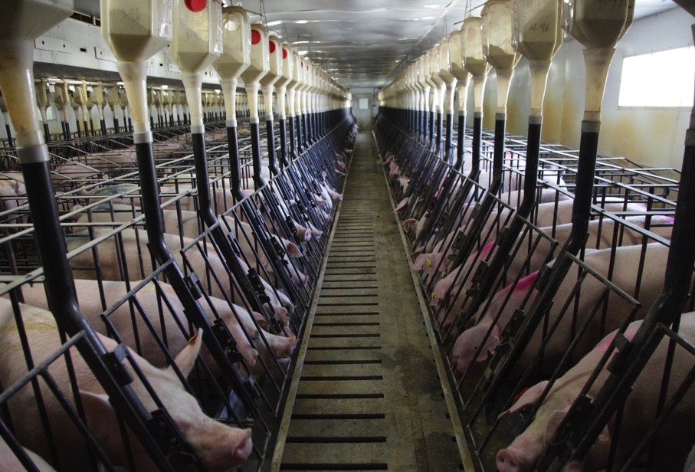
$pecial Interests: Marketing

Slide 42
$pecial Interests: Money
Big Ag worth $297 billion
Spent more than $126.9 million lobbying members of Congress and others in 2016
Including more than $2 million to then-candidate Donald J. Trump
Receives $38 billion in farm subsidies from taxpayers per year

Slide 43
$pecial Interests: Profiling AFBF
American Farm Bureau Federation
Spent $33.6 million lobbying in 2016
Employ 50 lobbyists
Fought hard against the Clean Water Act

Slide 44
$pecial Interests: Profiling AFBF

Slide 45
$pecial Interests: Profiling AFBF

Slide 46
$pecial Interests: North Carolina
1980s: NC tobacco industry withered
1980s: Wendell Murphy, pig farmer turned state senator, decided to “vertically integrate” pig farms by protecting them like family farms
Eliminated sales tax on hog/poultry houses
Waived sales taxes on all CAFO equipment
Passed laws prohibiting zoning ordinances

Slide 47
$pecial Interests: North Carolina
1995: Pulitzer Prize-winning journalists discover:
“[S]tate agencies aid the expansion of pork production but are slow to act on a growing range of problems resulting from that increase. The industry has won laws and policies promoting its rapid growth in North Carolina. It also has profited from a network of formal and informal alliances with powerful people in government.”
And without further ado…
https://www.youtube.com/watch?v=-mQYdE41hTM

Slide 48
North Carolina: Fighting Back
Community Empowerment
1) Organizing and informing
2) Advocacy and activism
3) Civil rights complaint

Slide 49
Actors
Community members
Advocacy organizations
Earthjustice, University of North Carolina Center for Civil Rights, Waterkeeper Alliance, North Carolina Environmental Justice Network (NCEJN), and Rural Empowerment Association for Community Help (REACH)
Professor Wing, public health professor at UNC
CAFO operators
WH Group
EPA External Civil Rights Compliance Office (ECRCO)
Formerly Office of Civil Rights (OCR)
Department of Environmental Quality (DEQ)
National Pork Council & NC Pork Council

Slide 50
Fighting Back: Organizing and Informing
Citizens have asked DEQ to help for decades
But “over the decades, complaints have largely fallen on deaf ears.” – Naeema Muhammad, director of NCEJN
Began collecting information in the 2000s
Professor Wing, public health professor at UNC
Devon Hall, REACH
Community members

Slide 51
Fighting Back: Organizing and Informing
Duplin Health Awareness Project
First of ten studies
Researchers monitored air quality within a mile of CAFOs for toxins and PM
Instructed community members to:
Sit outdoors and note odor intensity and their own daily stress levels
Track their blood pressure and lung function with medical equipment
Record all of their data
Notes:
(“Hall set up the equipment and asked residents to fill out a journal in the morning and in the evening. ‘There's more activity at the CAFOs around sunrise and sunset,’ Hall said. ‘Usually they're flushing out the waste first thing in the morning.’”).

Slide 52
Fighting Back: Organizing and Informing
Data showed correlations between pig waste and:
Asthma
Other respiratory problems like bronchitis
Compromised immune systems
Increased stress and anxiety

Slide 53
Fighting Back: Advocacy and Activism
Monitored air and water quality
Worked with Waterkeepr Alliance, who deployed Riverkeepers to take water samples
Created maps of CAFOs and lagoons and reported observed violations of the General Permit, like spraying before or during a storm
Went door-to-door distributing fact sheets
“We told them, this is how many pigs live around you, and this is who's making the money. We got good at mobilizing the community.” – Devon Hall, REACH

Slide 54
Fighting Back: Advocacy and Activism
Intimidation from CAFO operators
Harassment
Particularly of water samplers
Sustained tailgating
Yelling
Threats of gun and other physical violence
Driving back and forth in front of houses
Phone calls after reporting illegal activity to DEQ

Slide 55
Fighting Back: Advocacy and Activism
Violet Branch
70-year-old African American woman
Lives within 2 miles of 10 CAFOs
State agency told her to stop using her well
After CAFO operator found out, he came to her house
“[T]hat farmer came back with their industry spokesperson and asked me a lot of questions as if they were trying to make it seem like I was out to get the hog farmer.”
Asked her if she ever considered moving – she’s lived on her land since 1943

Slide 56
Fighting Back: Advocacy and Activism
Elsie Herring
African American woman
Lives next to sprayfields
Filed complaints with DEQ
Received letter from CAFO lawyer threatening her with jail time if she continued to complain
Violence and intimidation:
https://www.youtube.com/watch?v=FbTDGJxUdXo&feature=youtu.be

Slide 57
Fighting Back: The Last Straw
March 2014:
Community attempted to prevent DEQ from renewing General Permit in 2014 unless lagoon and sprayfield system was changed
DEQ renewed General Permit without change
Last straw:
“We’ve been asking the state and our representatives for years to do something different about how this industry operates in the state. It was an insult to the community and to the people of the state of North Carolina to renew those permits.” – Naeema Muhammad, director of NCEJN

Slide 58
Fighting Back: Civil Rights Complaint
September 2014:
Earthjustice and UNC Center for Civil Rights, on behalf of Waterkeeper Alliance, NCEJN, and REACH
Filed complaint in EPA External Civil Rights Compliance Office (ECRCO)
Under Title VI of Civil Rights Act of 1964 and implementing regulations (40 C.F.R. Part 7)
Under Title VI, state regulatory programs that receive federal funding may not operate in such a way that disproportionately impacts communities of color in a negative way.

Slide 59
Fighting Back: Civil Rights Complaint
Alleged:
“[T]he State’s lax regulation of hog-waste disposal discriminates against minority communities in eastern North Carolina, and that its [Department of Environmental Quality’s] recent permit allowing thousands of hog facilities to function without adequate waste-disposal controls violates federal law.

Slide 60
Fighting Back: Civil Rights Complaint
February 2015: ECRCO began investigating DEQ
March 2015: Parties agree to enter into ADR
Funded by EPA
National Pork Council and NC Pork Council moved to intervene
How did they know about proceedings…?
Citizens objected:
“On behalf of our clients, who were adamant that the Pork Council should not be at the table—this was not about them, it was about DEQ’s responsibility to protect the environment and health and safety of the people of North Carolina—we said no, there’s no place for you here.”

Slide 61
Fighting Back: Civil Rights Complaint
January 2016:
Pork industry shows up to mediation
DEQ makes it clear they support industry’s presence
Didn’t act surprised industry was there
Earthjustice attorney stated DEQ tried to “normalize the problem”
Community representatives concerned about exposing identities of those who were present
Negotiations broke down

Slide 62
Fighting Back: Civil Rights Complaint

Slide 63
Fighting Back: Civil Rights Complaint
March 2016: Community withdraws from mediation
May 2016: ECRCO reinstates DEQ investigation
July 2016: Community filed second complaint with ECRCO
Alleged DEQ “engaged in and failed to protect [the Citizens] from intimidation, which is prohibited by Title VI and EPA regulations, 40 C.F.R. § 7.100.”
Discussed long history of intimidation tactics
August 2016: ECRCO agrees to investigate DEQ based on the second complaint

Slide 64
Fighting Back: Civil Rights Complaint
October 2016:
20 community members go to Washington, D.C.
Meet with EPA and members of Congress
November 2016:
ECRCO visits North Carolina
Sen. Cory Booker visited too
Member of the Senate Environment and Public Works Committee

Slide 65
Fighting Back: Civil Rights Complaint
January 2017:
VICTORY: ECRCO sends DEQ Letter of Concern
“Unprecedented step”
Expess “deep concern about the possibility that African Americans, Latinos, and Native Americans have been subjected to discrimination as the result of NC DEQ’s operation of the Swine Waste General Permit program, including the 2014 renewal of the Swine Waste General Permit.”
Express “grave concerns about these reports indicating a potential hostile and intimidating environment for anyone seeking to provide relevant information to NC DEQ or EPA.”

Slide 66
Fighting Back: Civil Rights Complaint
ECRCO recommendations for DEQ:
Assess the Swine Waste General Permit to determine how it should be changed to substantially reduce impacts on nearby residents. The EPA also asked for a timeline.
Assess current regulations on industrialized hog farms and determined what could be changed. If the DEQ claims it doesn’t have the authority to change a rule, it needs to show evidence of the impediment.
Evaluate risk management options, such as covering the lagoons, not using dead boxes [a holding pen for hog carcasses] and not spraying on the weekends.

Slide 67
Fighting Back: Civil Rights Complaint
ECRCO recommendations for DEQ:
Assess current swine waste technologies and what could be adopted.
Conduct an internal evaluation of DEQ’s enforcement and compliance of industrialized hog farms. If corrective measures are needed, deliver a timetable to do so.
Evaluate its non-discrimination program if its [sic] in place, using a federal checklist. If the program hasn’t been established, DEQ is to correct the deficiencies.

Slide 68
EPA In Jeopardy: Next Steps at State Level?
Repeal “Right-to-Farm”
Repeal Ag-Gag
Fund DEQ
Continue to exert pressure on DEQ to update the General Permit by banning lagoon and sprayfield waste management systems
Or at least force them to use some kind of control technology to reduce emissions from lagoons
Petition DEQ to establish an environmental justice department to ensure Title VI compliance, as recommended
Notes:
Under a 2000 agreement between Smithfield and the then-NC Attorney General Roy Cooper, Smithfield agreed to spend $15 million on research for environmentally superior technology.
Projections show that it would cost approximately $5.4 billion 10 years to retrofit all permitted farms in North Carolina to such a technology
But cost is really cheaper for some stuff like anaerobic digesters and biogas when you account for grants, loans, federal programs, etc.
But NC hasn’t taken advantage of these programs, and they might disappear under Trump anyway

